Slide 1
Data science jobs and salaries analysis
Szőllősi Szilárd-Árpád

Slide 2
Objectives
Our objective is to analyze the data , and create charts , that can be used to visualize the data in a way that enables businesses to get relevant data.

Slide 3
The data
Our data contains informations about employees :
Salary , job title , job category , experience,etc.
Analyzing helps businesses create competent offers for example ,when they are looking for new candidates , or to determine what type of candidates would be suitable for their needs.

Slide 4
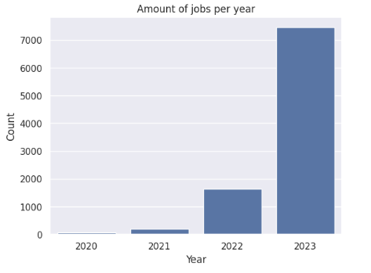
Yearly asessment
Here we can see the exponential increase in the number of data related jobs from over the years. While in 2020 the number of jobs is close to 0 , in 2023 we have information about over 7000 employees working in data related fields.

Slide 5
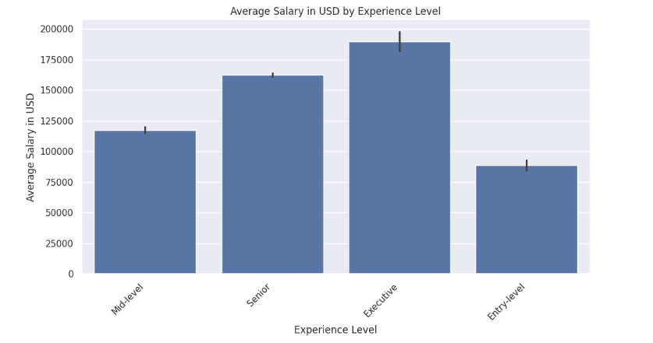
Yearly asessment
This plot show us the average salary based on an employees experience level. It’s visible that the more experience an employee has , the higher the salary becomes . Based on this chart the company can determine if it is worth it for them to hire somebody with more experience , or somebody with less experience , but a smaller salary would bring more benefits to the company.

Slide 6
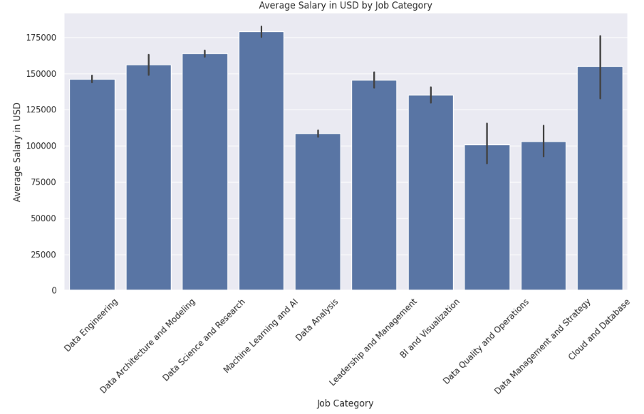
Salary based on job category
Here we can see the average salary for each job category , in USD , the one with the highest average is Data Science and Research m and the lowest one is BI and Visualization.

Slide 7
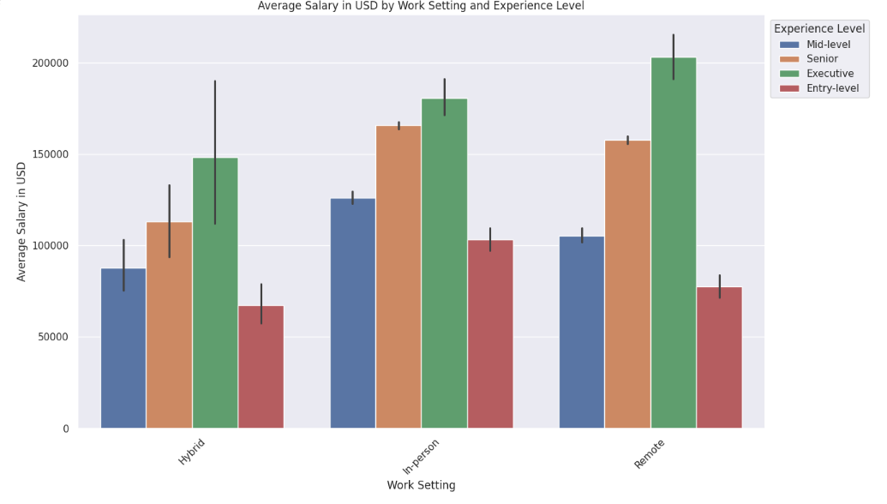
Salary based on experience and work setting
In this plot I have compared the average salary for each type of work setting : hybrid , in-person and remote . For each type of work setting I displayed the average based on experience level. We can see that the salary based on the work setting seems to be the highest for the employees that are going to work “In-person” , and the lowest for those that are doing “hybrid” work.
The remote workers salary sits between the other two fields values , except for Executives.

Slide 8
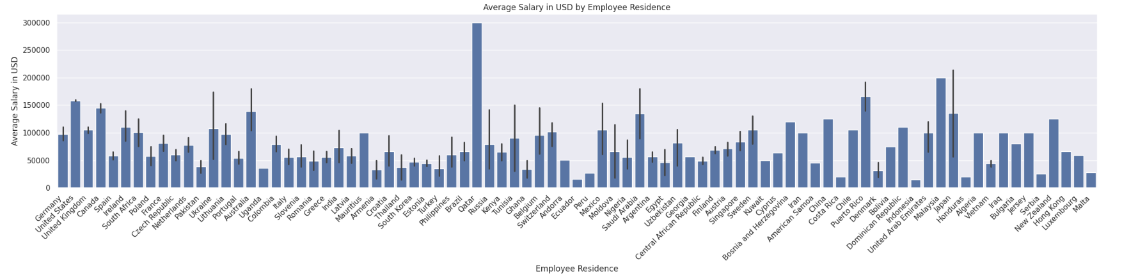
Salary based on employees residence
This plot shows us the difference between the salaries , of the different employees from different states. This data is useful to know in which countries can we find the best work force for the best value.

Slide 9
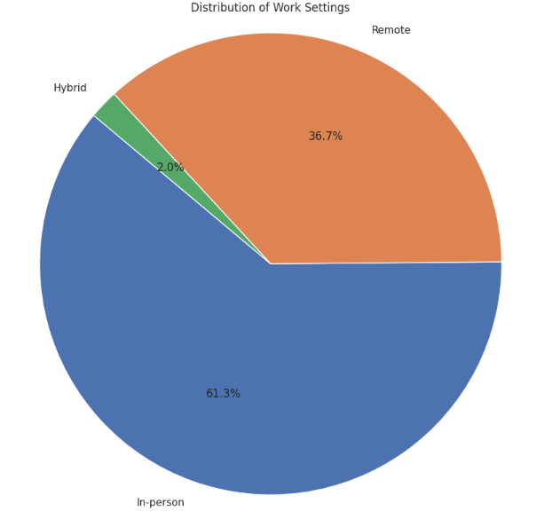
Distribution of work settings
Here we can see the distribution of the jobs from our data , more exactly the proportion of the people working remotely , in-person or with a hybrid program.

Slide 10
SUMMARY
There was a significant increase in data related jobs between 2020 and 2023. The salary of an employee can be influenced in different ways , based on where the person lives , what kind of experience it has and based on the work setup. We can see that people mostly prefer doing their work either in-person or remotely , but only a few chose to work with a hybrid setup.

Slide 11
THANK YOU
Szőllősi Szilárd-Árpád
https://github.com/SzSzilard03/OesonProject2

